Slide 1



CAREER TRAJECTORY ANALYSIS
RIYA RAJESH
26-06-2025
DA-DS
March Batch
1/23

Slide 2

TABLE OF CONTENT
Pivot Tables and Charts
Dashboard
Key Insights
Recommendations
Conclusion
Objective
Dataset Overview
Data Cleaning Process
SQL queries performed
2/23

Slide 3
OBJECTIVE:
Understand salary patterns across roles, industries, and demographics
Identify factors influencing compensation (education, gender, geography)
GOAL:
Clean and preprocess the dataset
Load into MySQL for querying
Extract insights using SQL
Visualize results via Excel pivot charts
Build an interactive dashboard
3/23

Slide 4
DATASET DESCRIPTION:
Source: Global Salary Survey Dataset
Dataset contains about 28104 rows and 14 columns
Key Attributes:
Age, Gender, Country, Industry
Job Title, Education, Experience
Annual Salary & Additional Compensation
4/23

Slide 5
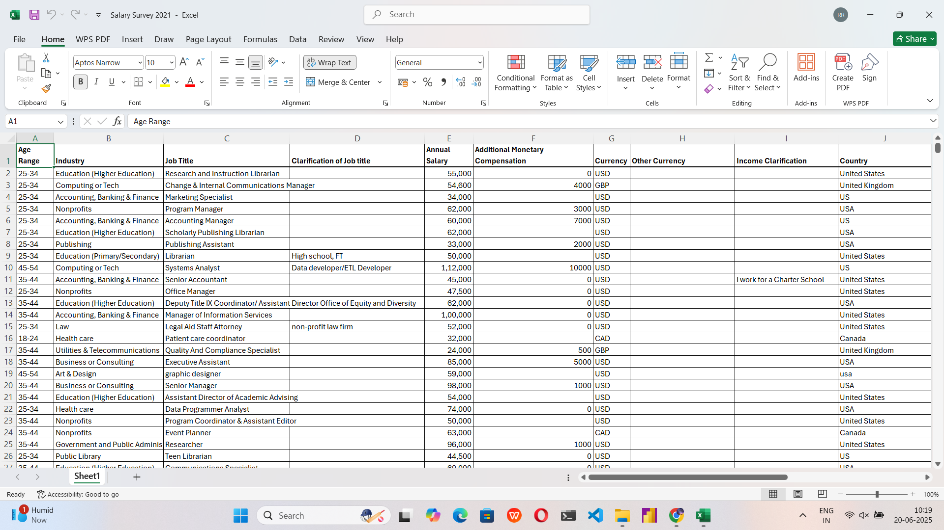

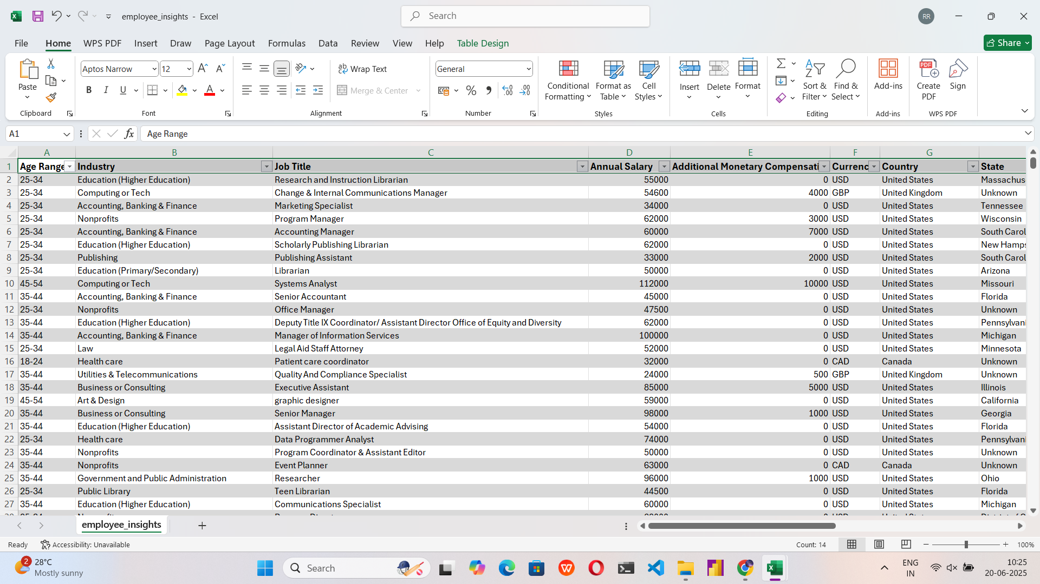
DATA CLEANING AND TRANSFORMATION:
Handle missing values
Standardize data types
Detect and manage outliers
5/23

Slide 6
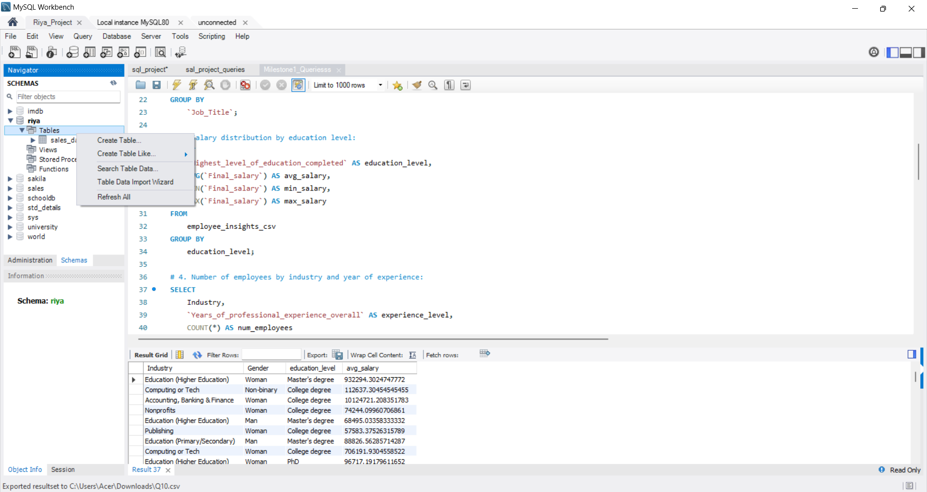
SQL QUERIES:
‘Save As’ the Excel file in CSV format
SQL workbench - Database - Table - (right click) - Table data import wizard
Import the saved CSV file and load
Run queries and export back to Excel
6/23

Slide 7
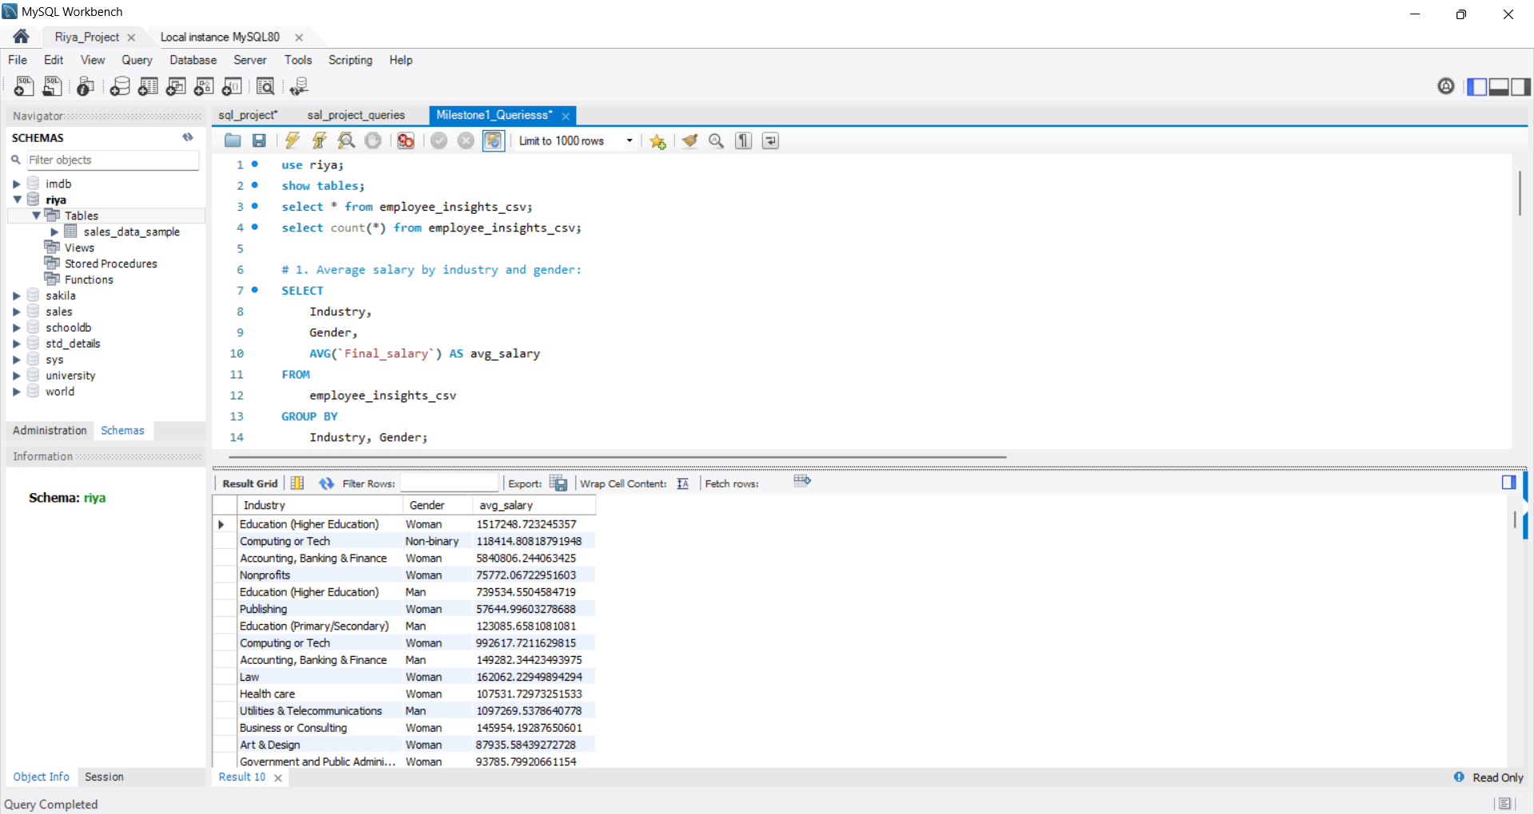
SQL QUERIES:
AVERAGE SALARY BY INDUSTRY AND GENDER
7/23

Slide 8
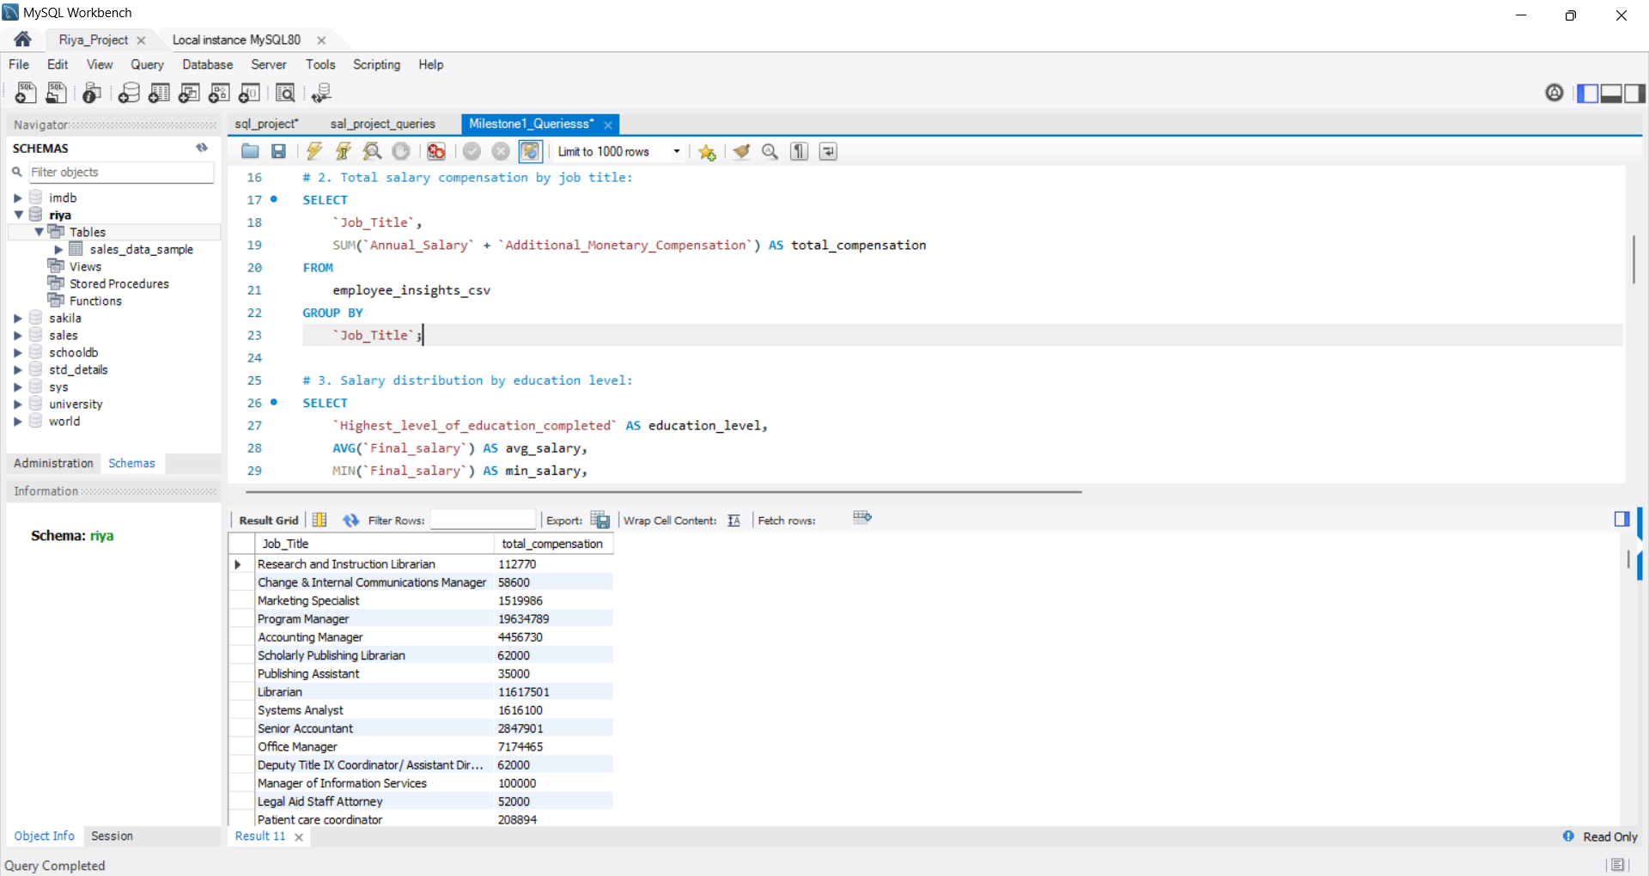
TOTAL SALARY COMPENSATION BY JOB TITLE
8/23

Slide 9
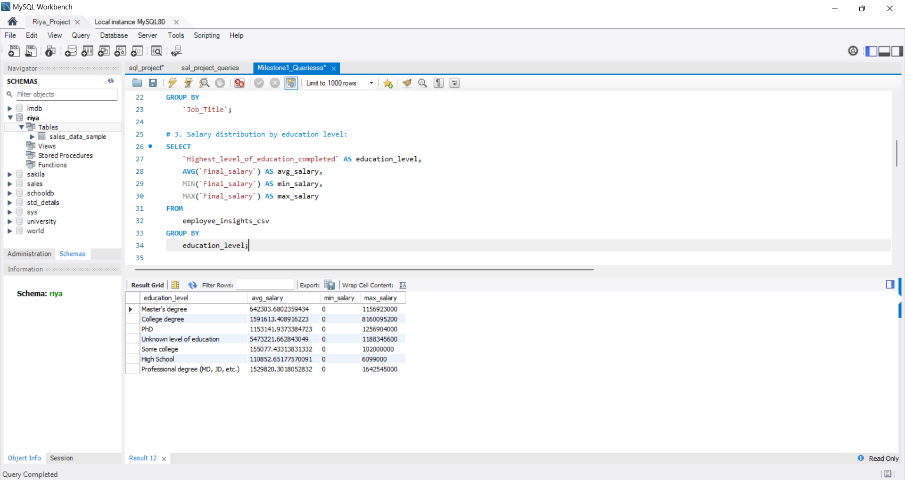
SALARY DISTRIBUTION BY EDUCATION LEVEL
9/23

Slide 10
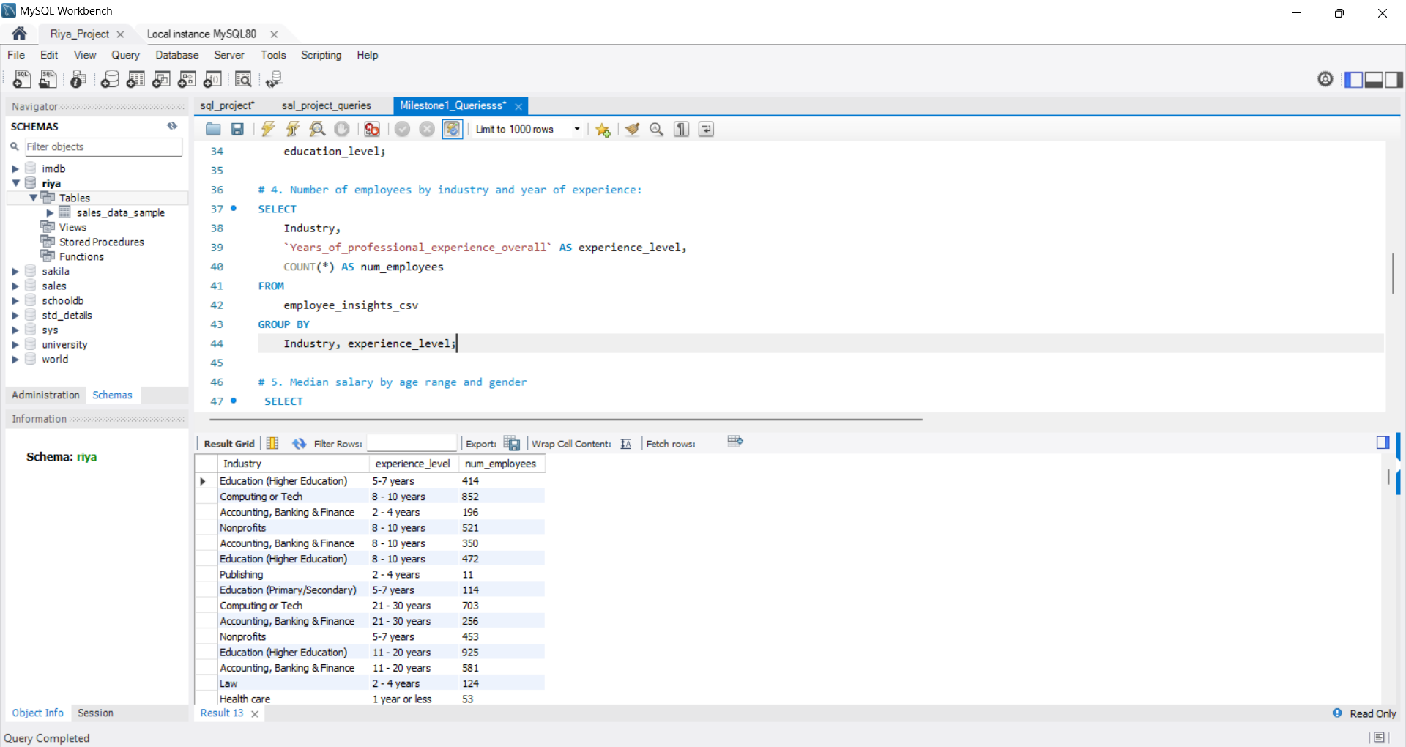
NUMBER OF EMPLOYEES BY INDUSTRY AND YEARS OF EXPERIENCE
10/23

Slide 11
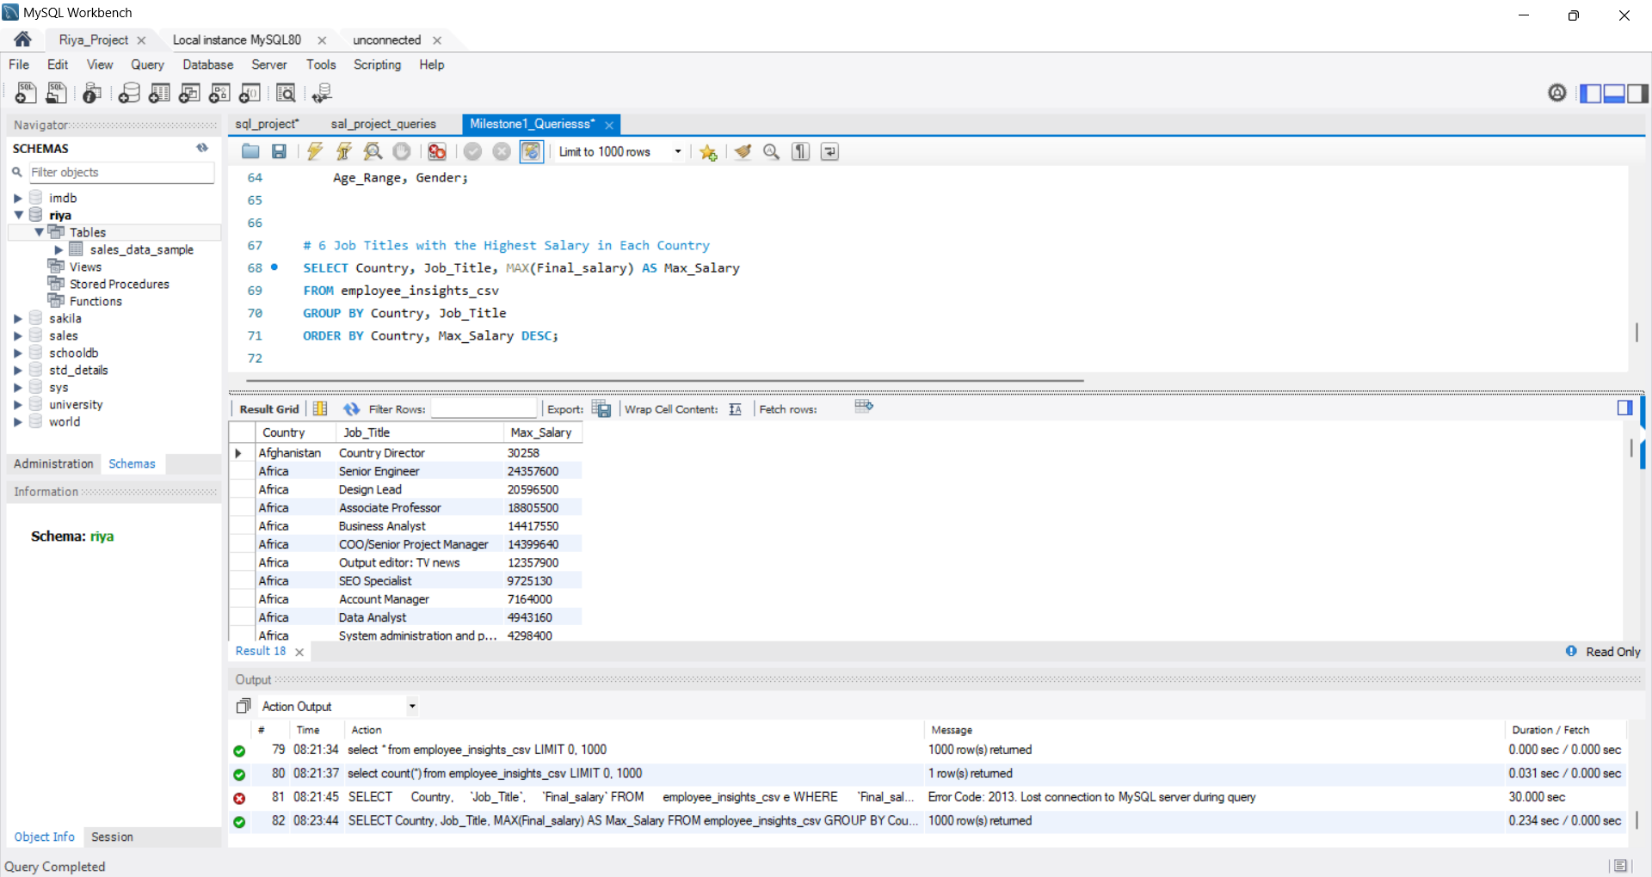
JOB TITLES WITH THE HIGHEST SALARY IN EACH COUNTRY
11/23

Slide 12
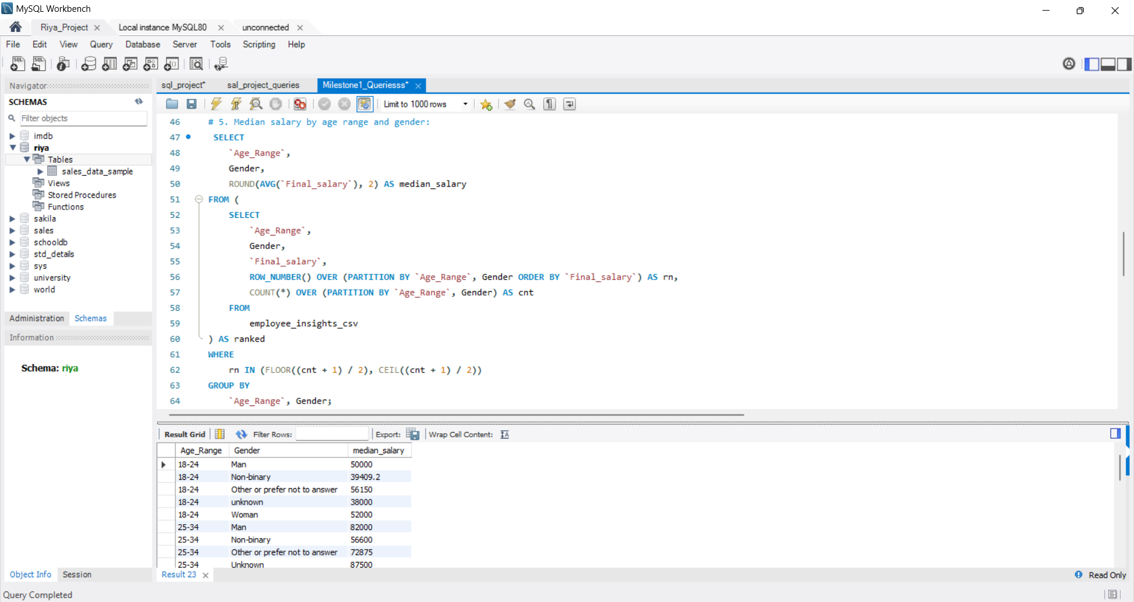
MEDIAN SALARY BY AGE RANGE AND GENDER
12/23

Slide 13
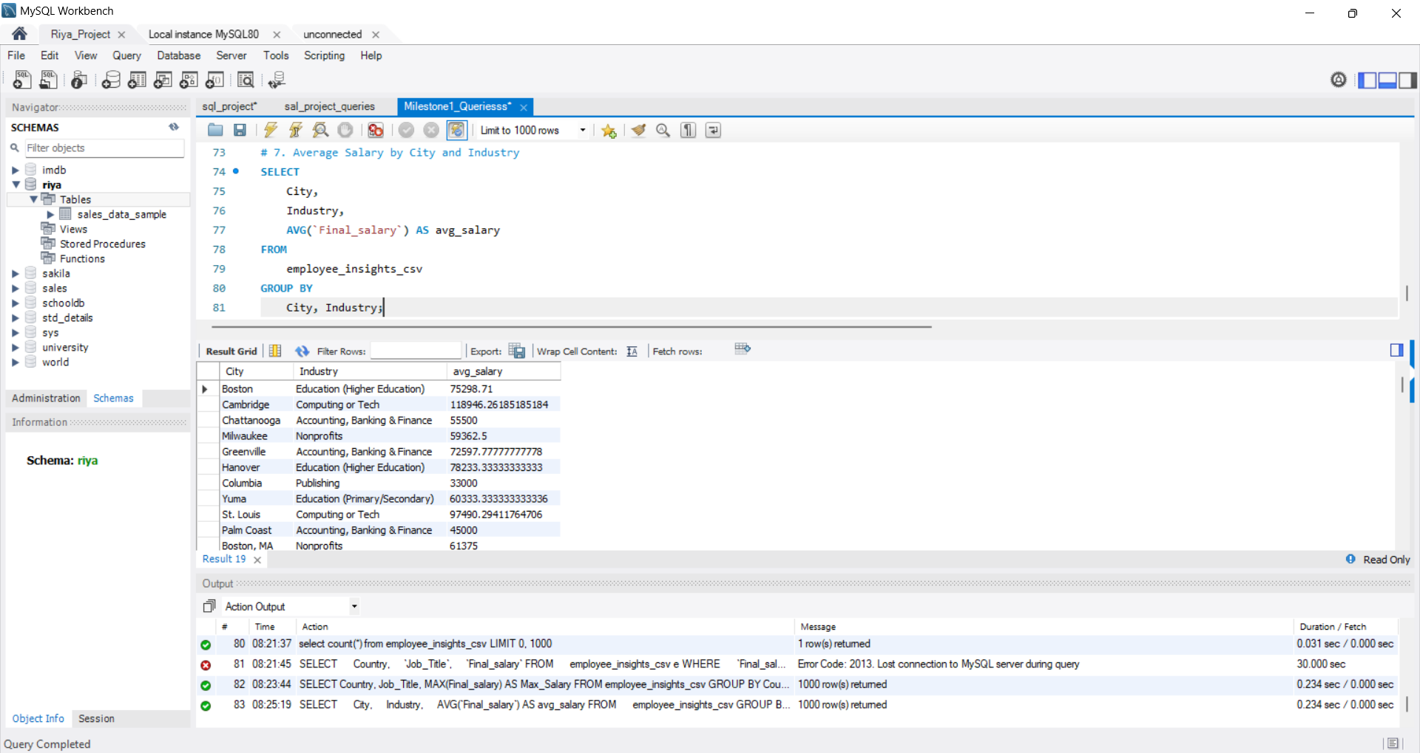
AVERAGE SALARY BY CITY AND INDUSTRY
13/23

Slide 14
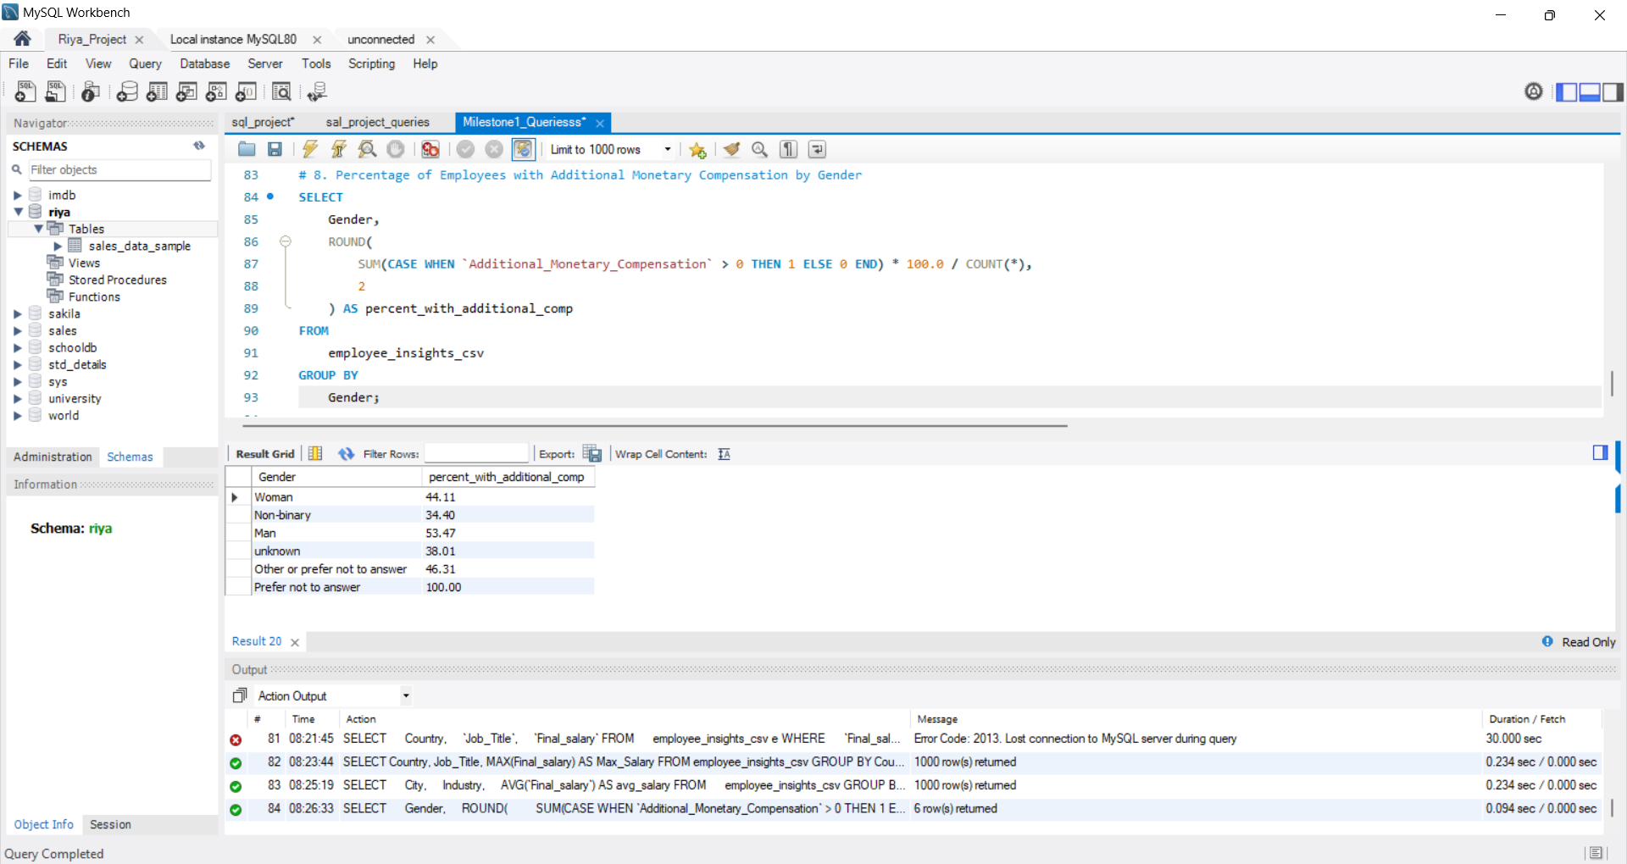
PERCENTAGE OF EMPLOYEES WITH ADDITIONAL MONETARY COMPENSATION BY GENDER
14/23

Slide 15
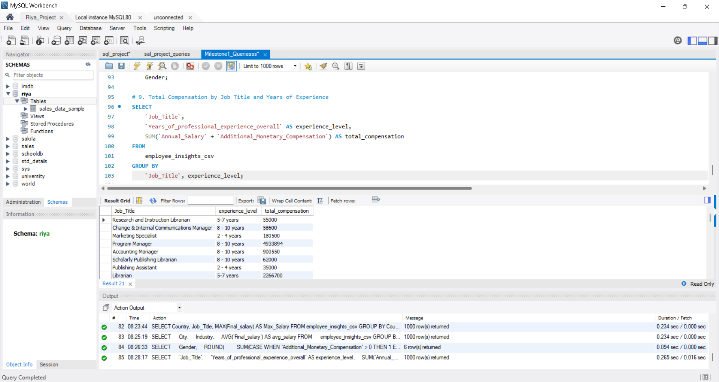
TOTAL COMPENSATION BY JOB TITLE AND YEARS OF EXPERIENCE
15/23

Slide 16
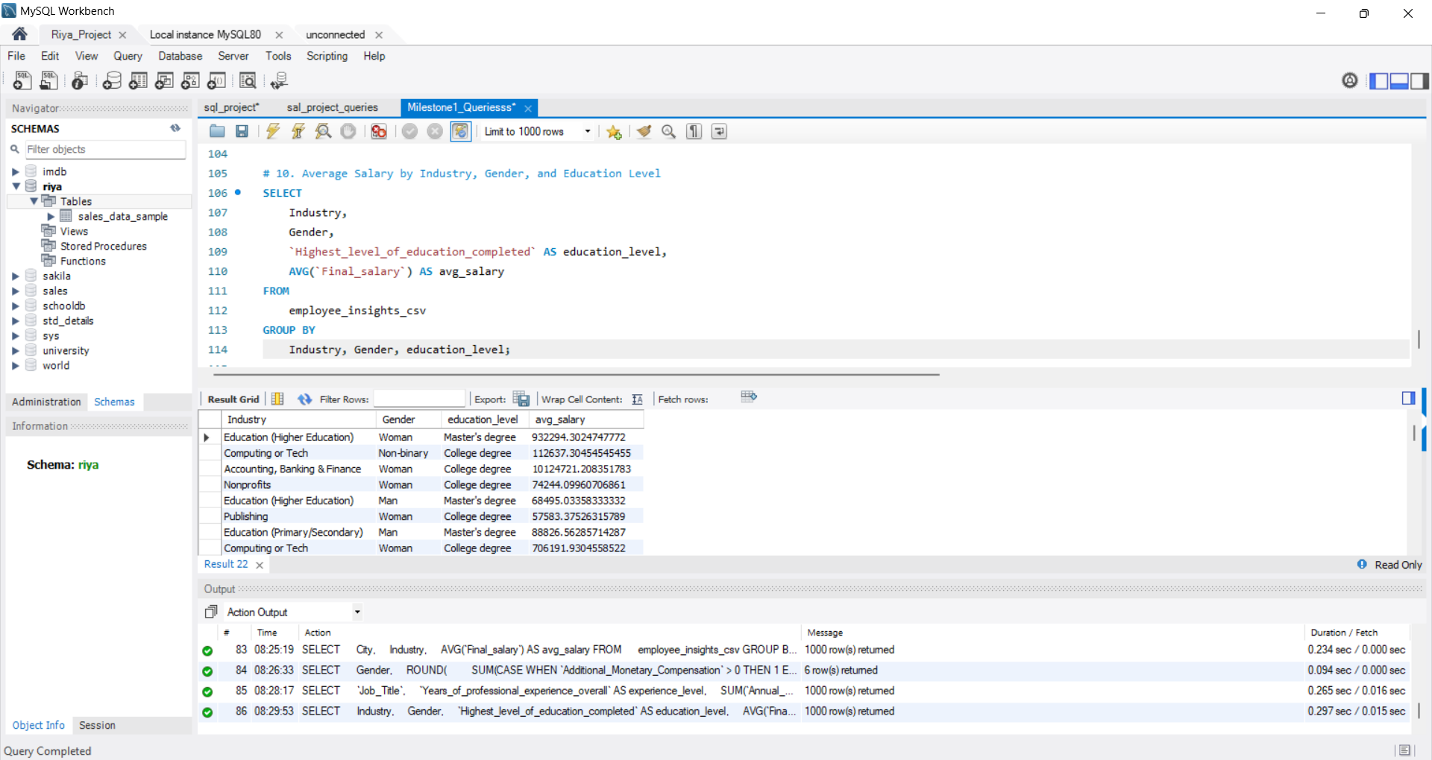
AVERAGE SALARY BY INDUSTRY, GENDER AND EDUCATION LEVEL
16/23

Slide 17
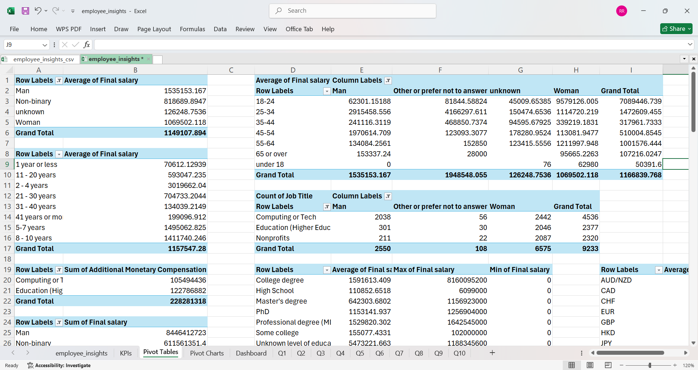
PIVOT TABLES:
17/23

Slide 18
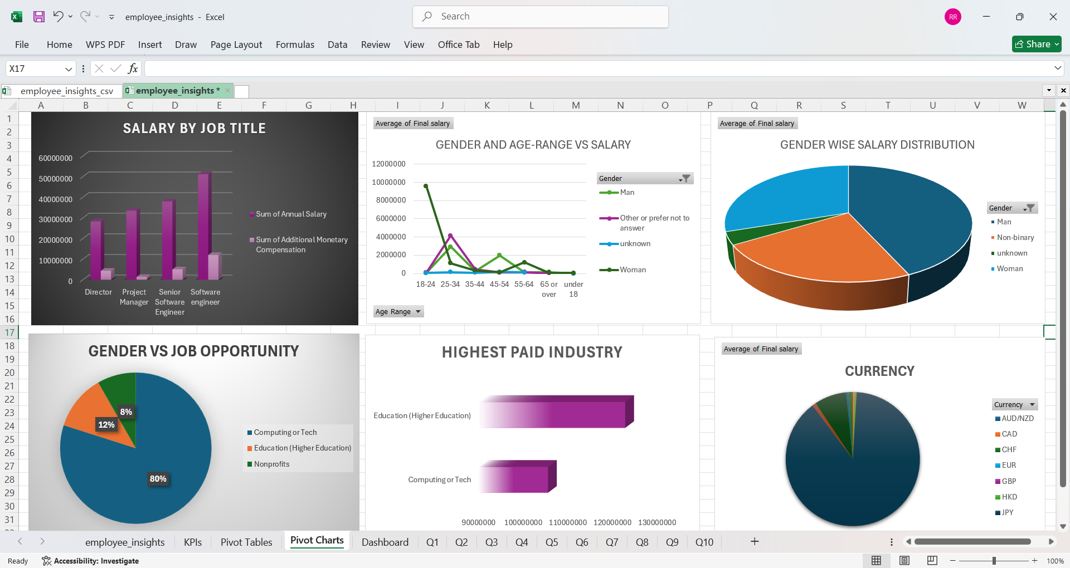
PIVOT CHARTS:
18/23

Slide 19
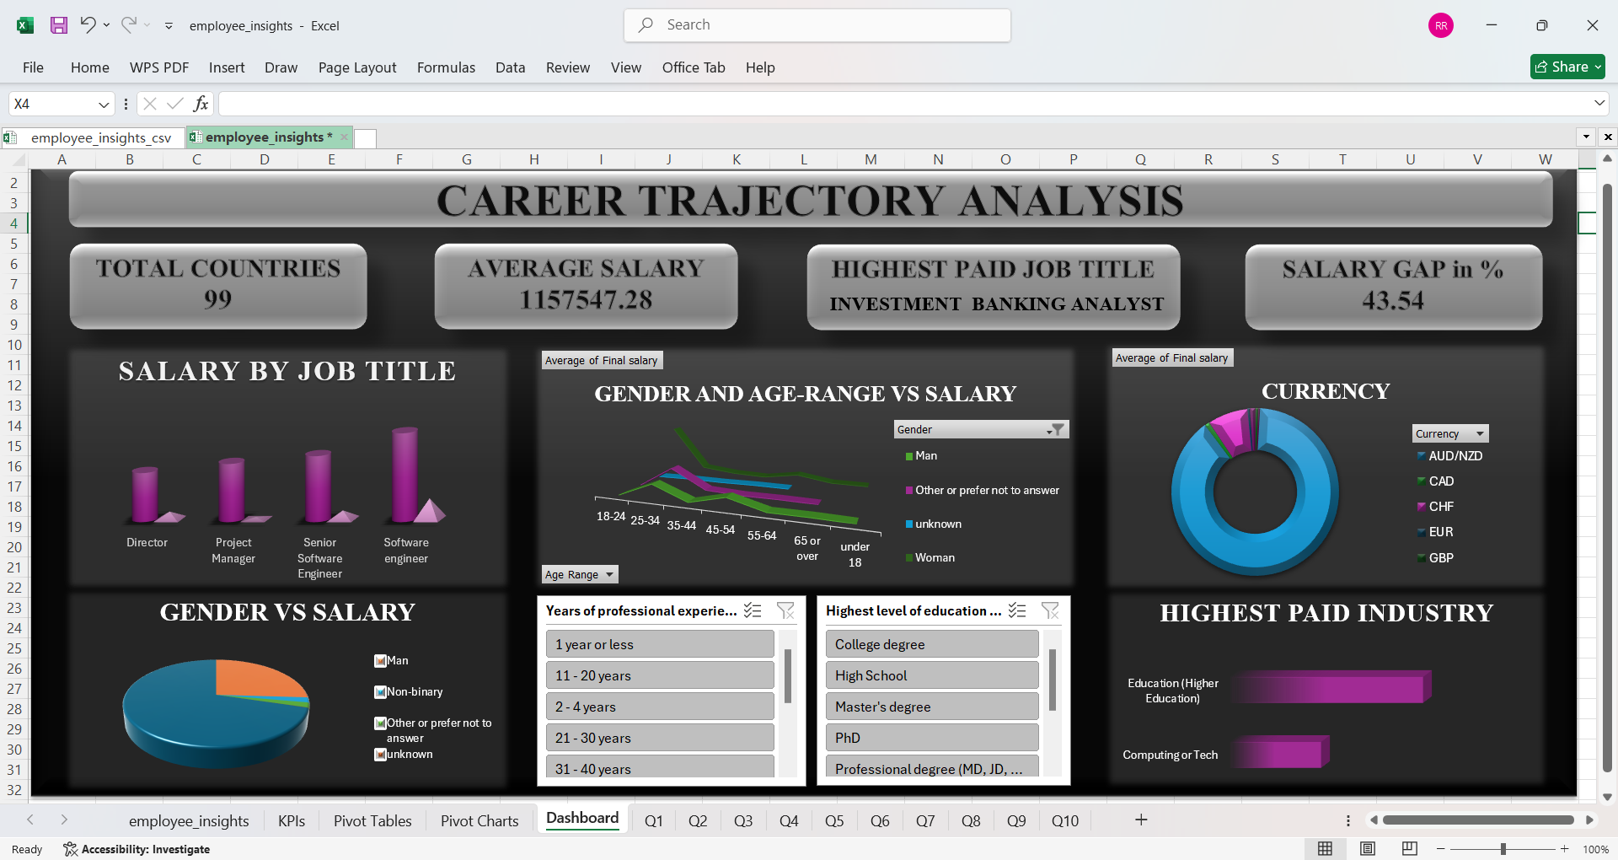
DASHBOARD:
19/23

Slide 20
KEY INSIGHTS:
Tech & Finance show highest average salaries
Gender pay gaps observed in multiple industries
Advanced degrees generally lead to higher earnings
Urban centers offer higher compensation
20/23

Slide 21
RECOMMENDATIONS:
Promote Pay Transparency
Encourage Skill Development
Geographic Compensation Adjustment
Attract Talent with Competitive Roles
Address Gender Pay Gaps
Optimize Compensation Packages
Focus on Retention in High-Experience Segments
Refine Hiring Strategy by Industry Trends
21/23

Slide 22
CONCLUSION:
Thorough analysis of salary trends across industries, roles, education and demographics.
Industry, experience, and education level are major drivers of salary variations.
Notable gender-based pay disparities identified across certain sectors.
High-paying roles and cities were clearly highlighted through SQL analysis.
Additional compensation (bonuses, incentives) were more common in specific job roles
22/23

Slide 23
THANK YOU
23/23

